Slide 1


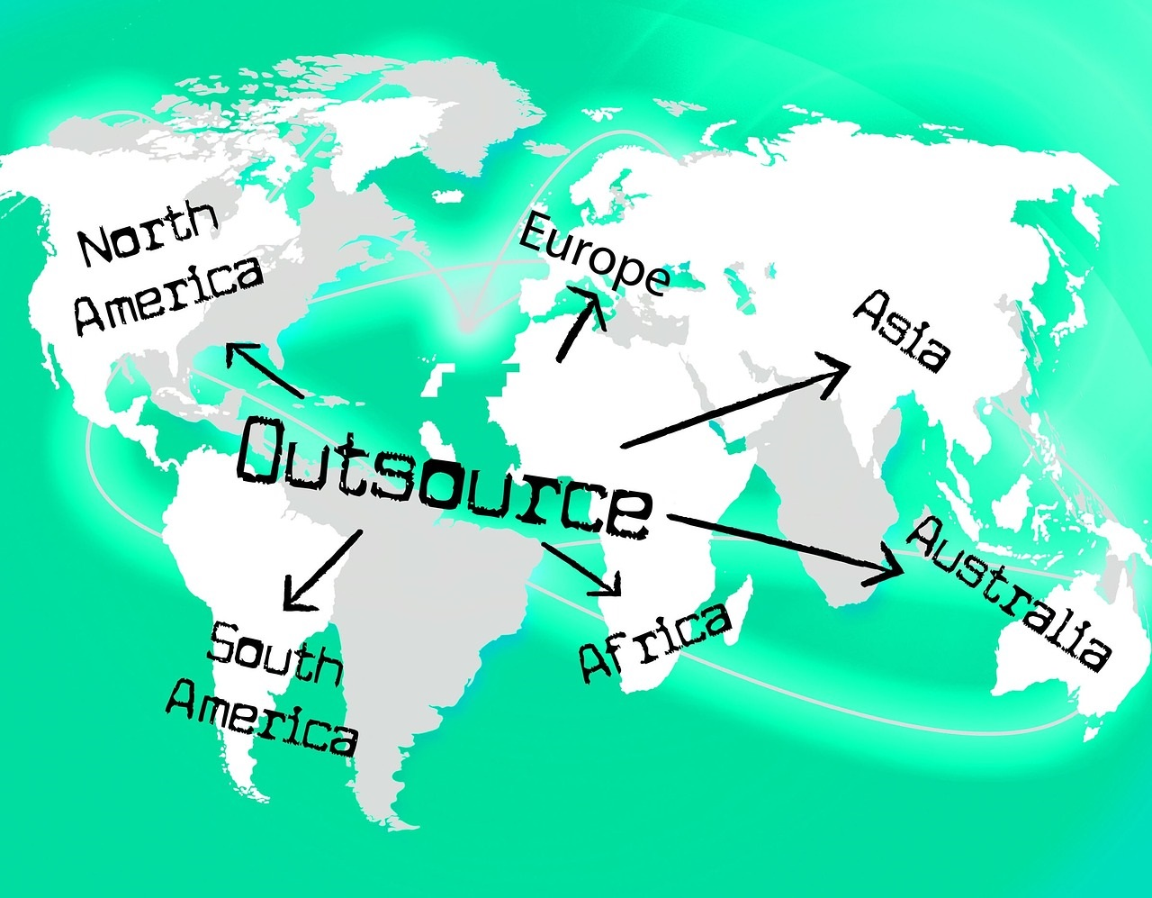


Xavier Solutions
For all your IT Solutions and Outsourcing Needs
“A promise well-kept!”
Abu Talha Chowdhury
Okaima O Olubunmi
This Photo by Unknown author is licensed under CC BY-SA-NC.

Slide 2
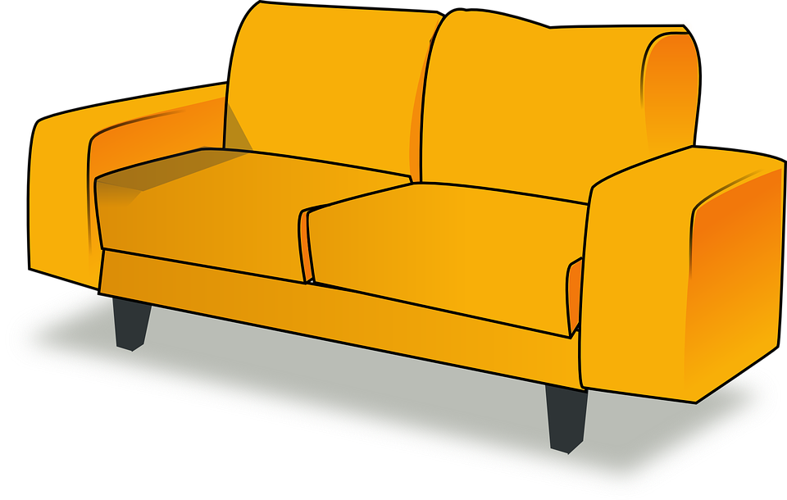
What should you outsource, and why?
I.T. Components: It seems like the ones you currently have are outdated. We can imagine that the old systems are also a pain to uphold and are very costly to continually fix when they break down; you do not want to lose all your mainframe data if they do.
I.T. Professionals: You’ll also need the latest I.T. professionals to help. These should be outsourced if you are not as knowledgeable about new systems.
We want you to focus on your main business; the furniture! Let us help you do that by handling the I.T. related aspects.

Slide 3

How we can help!
I.T. Components: Hardware and Software are expensive, and the longer you wait, the more expensive they can become to replace. You can cut the cost by outsourcing these to us; our systems are very affordable!
We specialize in newer components and can help you set them up cheaper if you work with us.
I.T. Professionals: It might be best to outsource these to us, as we will have better knowledge of newer system. We can train any I.T. professionals you might have to maintain the system afterward.

Slide 4

How we can help!
We understand that your main problem is surrounded around the fact that you have old mainframe systems; this can unfortunately, be a problem for the future as technology is always changing.
We promise to deliver the most robust, up to date, and scalable hardware, so that your new mainframe hardware can process all your financial data, transactions and calculations faster and more efficiently than ever before, saving you both time and money!
We also have a business structure in place that might be able to help you get rid of your other costs if you wish, as we are more than just an I.T. company!
We have the world-renowned Xavier IT-3 System in addition to the hardware support that we offer! Stay tuned to learn more!

Slide 5


How we can help!
Xavier IT-3 System
Efficient IT Structure
3D Printing System

Slide 6


Efficient IT Structure:
Unused Service
Waste Management
Error Statistics
Inventory Management
Invoicing
Sales Analysis
Automation
Business Process Management Structure
Identify Inefficiencies

Slide 7
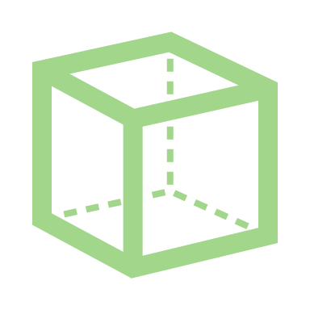

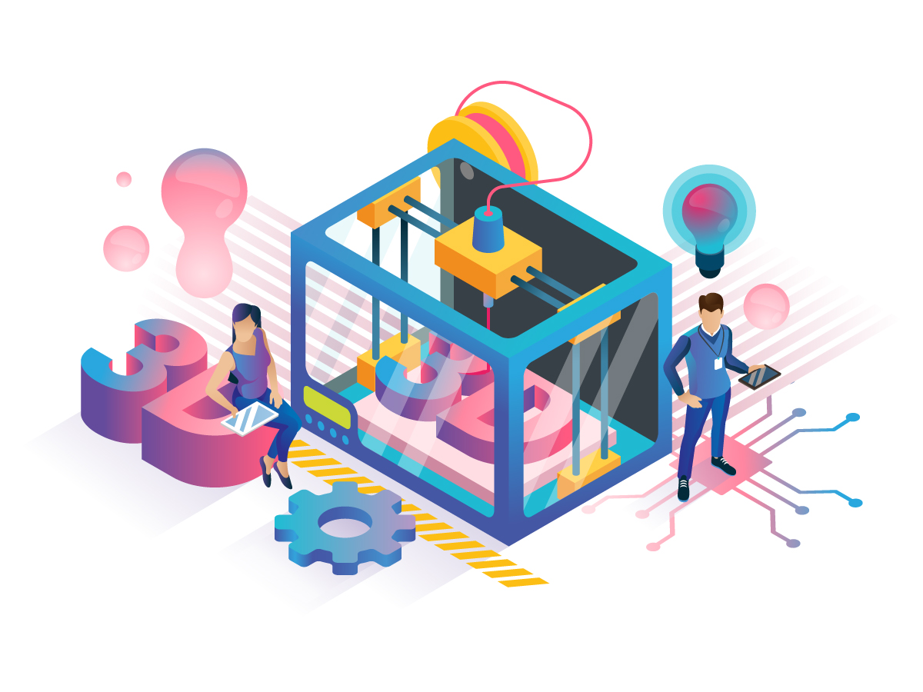


3D Printing System:
Making Components
Prototyping
3D printed tools

Slide 8


Our Previous Experience
Xavier Solutions is an IT solution and Outsourcing Company. We have a partnership agreement with Microsoft and Teams to ensure that our systems and solution are rugged enough to ride on any platform. Our biggest clients are Tyndale House, Dadex Computers and House of Theodore. These are blue-chip companies, and we are considered their major service-provider.
We fully understand that we have competition and that our industry is an evolving one, as such our Developers work tirelessly to keep abreast of the latest trends in Technology to deliver to our clients modern and world-class IT Solutions second-to-none in the industry.
Some of our past projects of similar features with clients in your industry are:
The Waterfall Project for Turaya Furnitures
The Horse-fall Project for Keep-IT-Trendy Company and
The Brazen Horse Project for Karl Maxx Furnitures.
We fully understand that these are your closest competitors and their annual financial profits after tax speak for us.

Slide 9
Our Previous Experience (continued)
We understand that you have a “NEED”, which is to have systems that are not only modern but robust enough to cater to both your internal and external processes. We also understand that your processes are data-driven and that you need your staff to be able to interphase seamlessly with these systems. This we can do, as our systems are user-friendly, have a high speed of processing and are customized to the need of our individual clients, because we believe that every customer is unique. As such, no solution should be a one-size-fits-all.
Our systems are not only affordable but very efficient and will help to drive down your Operational costs and improve your business processes.
As a company, we believe that our relationship with our customers should not be a one-off transaction but should be for a lifetime. As such, we offer to our clients:
A free training for their internal IT staff at on-boarding, so they can conduct first-level maintenance on their own
Free software download compatible with your existing application and handover of the software codes
A free quarterly second-level maintenance and replacement of computer parts up to a certain amount and
An SLA of 24 hours, depending on our client’s location
50% discount on system upgrade packages when necessary

Slide 10

Our Promise to You
At Xavier Solutions, our goal is to leave every customer excited and talking about our products and services long after a completed project, because it is our conviction that our customers are our greatest asset. We would like for you to give us the opportunity to make you experience what our customers say about us and what we are best known for. Which is to deliver to you “Our Promise” to keep you excited. We want you to be fully assured that we will not just be delivering to you a product, but “The Experience” of a lifetime.
This Photo by Unknown Author is licensed under CC BY

Slide 11

Thank you for inviting us to present. We look forward to working with you soon! -Xavier Solutions
z

Slide 12

Possible client invitation to tender questions
What kind of company do you normally work for? Have you worked for clients in the same industry as ours?
Have you done projects similar to mine as regarding IT features? Have you done projects of similar size and features before?
How do you intend to the deliver a product that will match both our expectations and our clients’ expectation?
Who are the people that make up your team?
What are the terms of your service level agreement?
Surajudeen Adedayo
This Photo by Unknown author is licensed under CC BY-NC-ND.

Slide 13
Possible client invitation to tender questions
How do you handle communication during projects?
What files or information will we have access to during the project?
What level of document security and data privacy do you offer?
Do you have references from your previous clients?
How much will the project cost and what makes up the costs?
What makes you the best choice?
This Photo by Unknown author is licensed under CC BY-NC-ND.

